Slide 1

Hour of code
December 4th
During your free period
Room 238
Minecraft Adventurer

Slide 2


Slide 3


Slide 4


Slide 5
Design and drawing for production
Unit 6 – Multiview Drawing
Section 1 – Orthographic Projections

Slide 6
The big idea
Process of explaining three-dimensional objects in two-dimensions
Called Orthographic Projections or Multiview Drawings
Typically have three views

Slide 7
Multiview drawing
A major type of drawing used in industry
The views show size and shape of an object
They are arranged in such a way to incorporate projections
Top view is always above the front view
The right-side view normally appears to the right of the front view
Lines are either parallel or perpendicular to one another

Slide 8
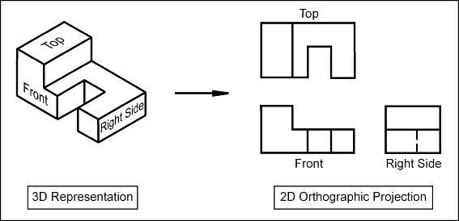

Slide 9
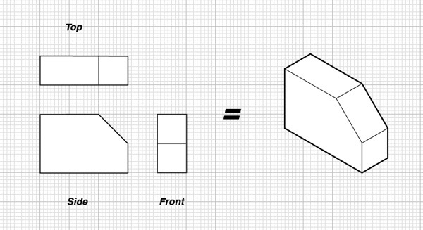

Slide 12
Laying out and finishing
Draw light construction lines to start
Check measurements carefully using construction lines and ticks
Check for any missing lines while laying out the objects and views
Remove any not needed construction lines
Darken in lines
Letter notes and title block
Check finished drawing carefully

Slide 13
Multiview Drawing #15
Multiview Drawing Unit

Slide 14
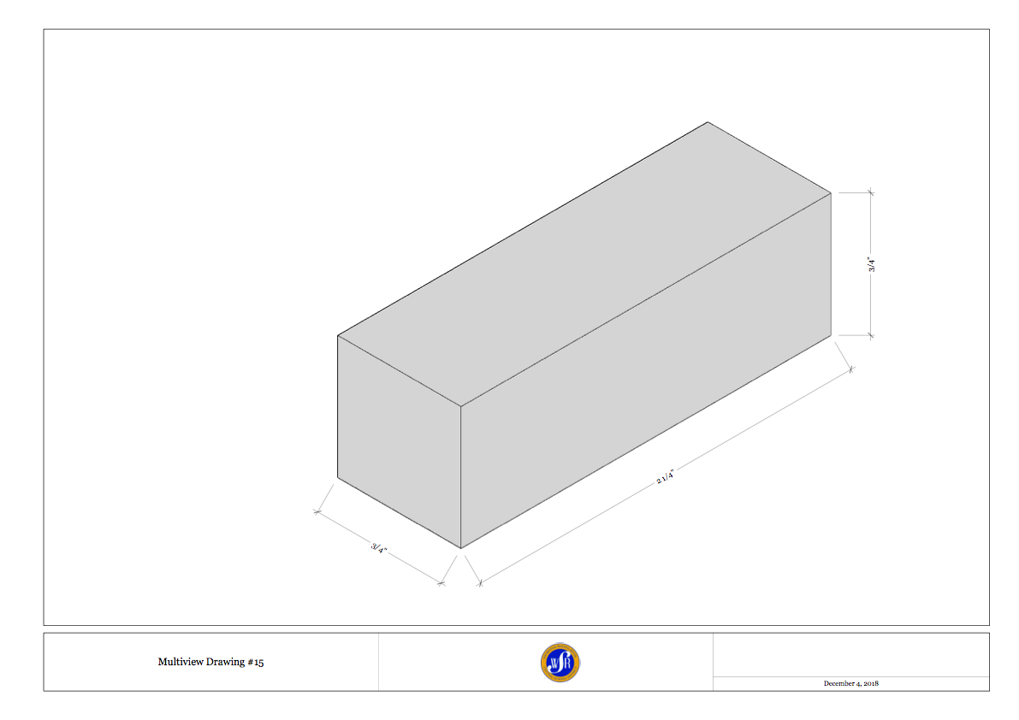

Slide 15
45 degree projection

Slide 16
45 degree projection line
Helps layout orthographic views
Creates depth
Aligns shape with respect to front and top views

